Slide 1


WELCOME
To our
Presentation

Slide 2
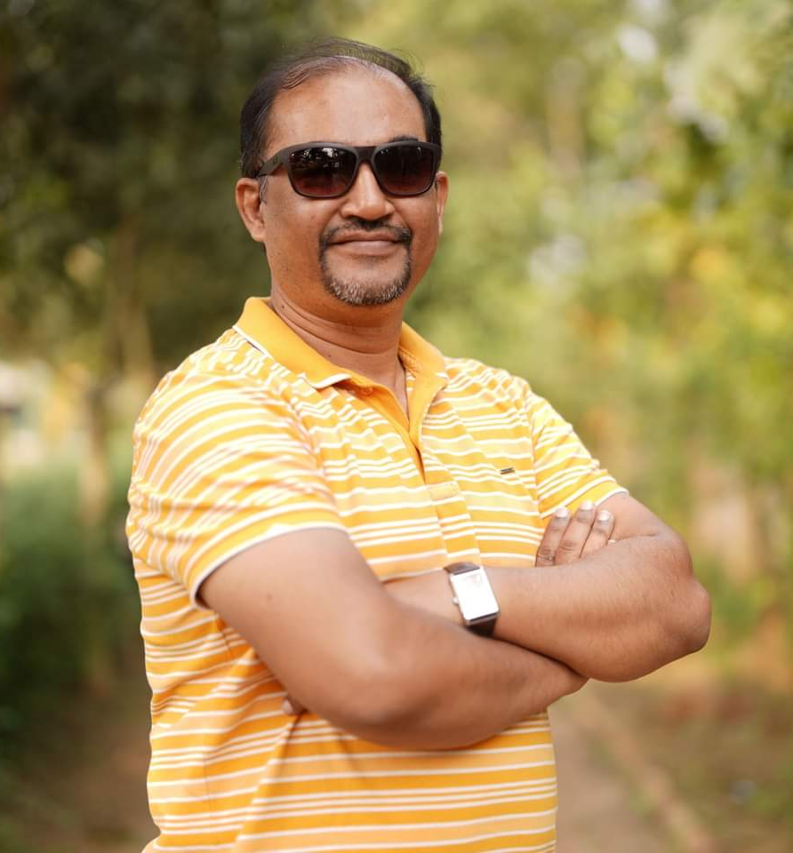
Presented To
Dr. Shamim H Ripon
Professor Department of Computer Science & Engineering

Slide 3
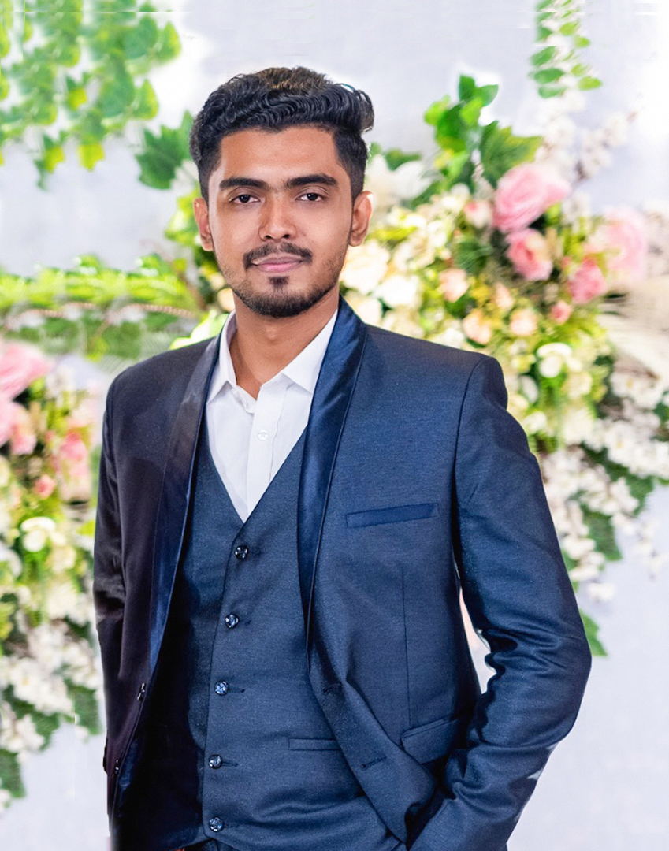
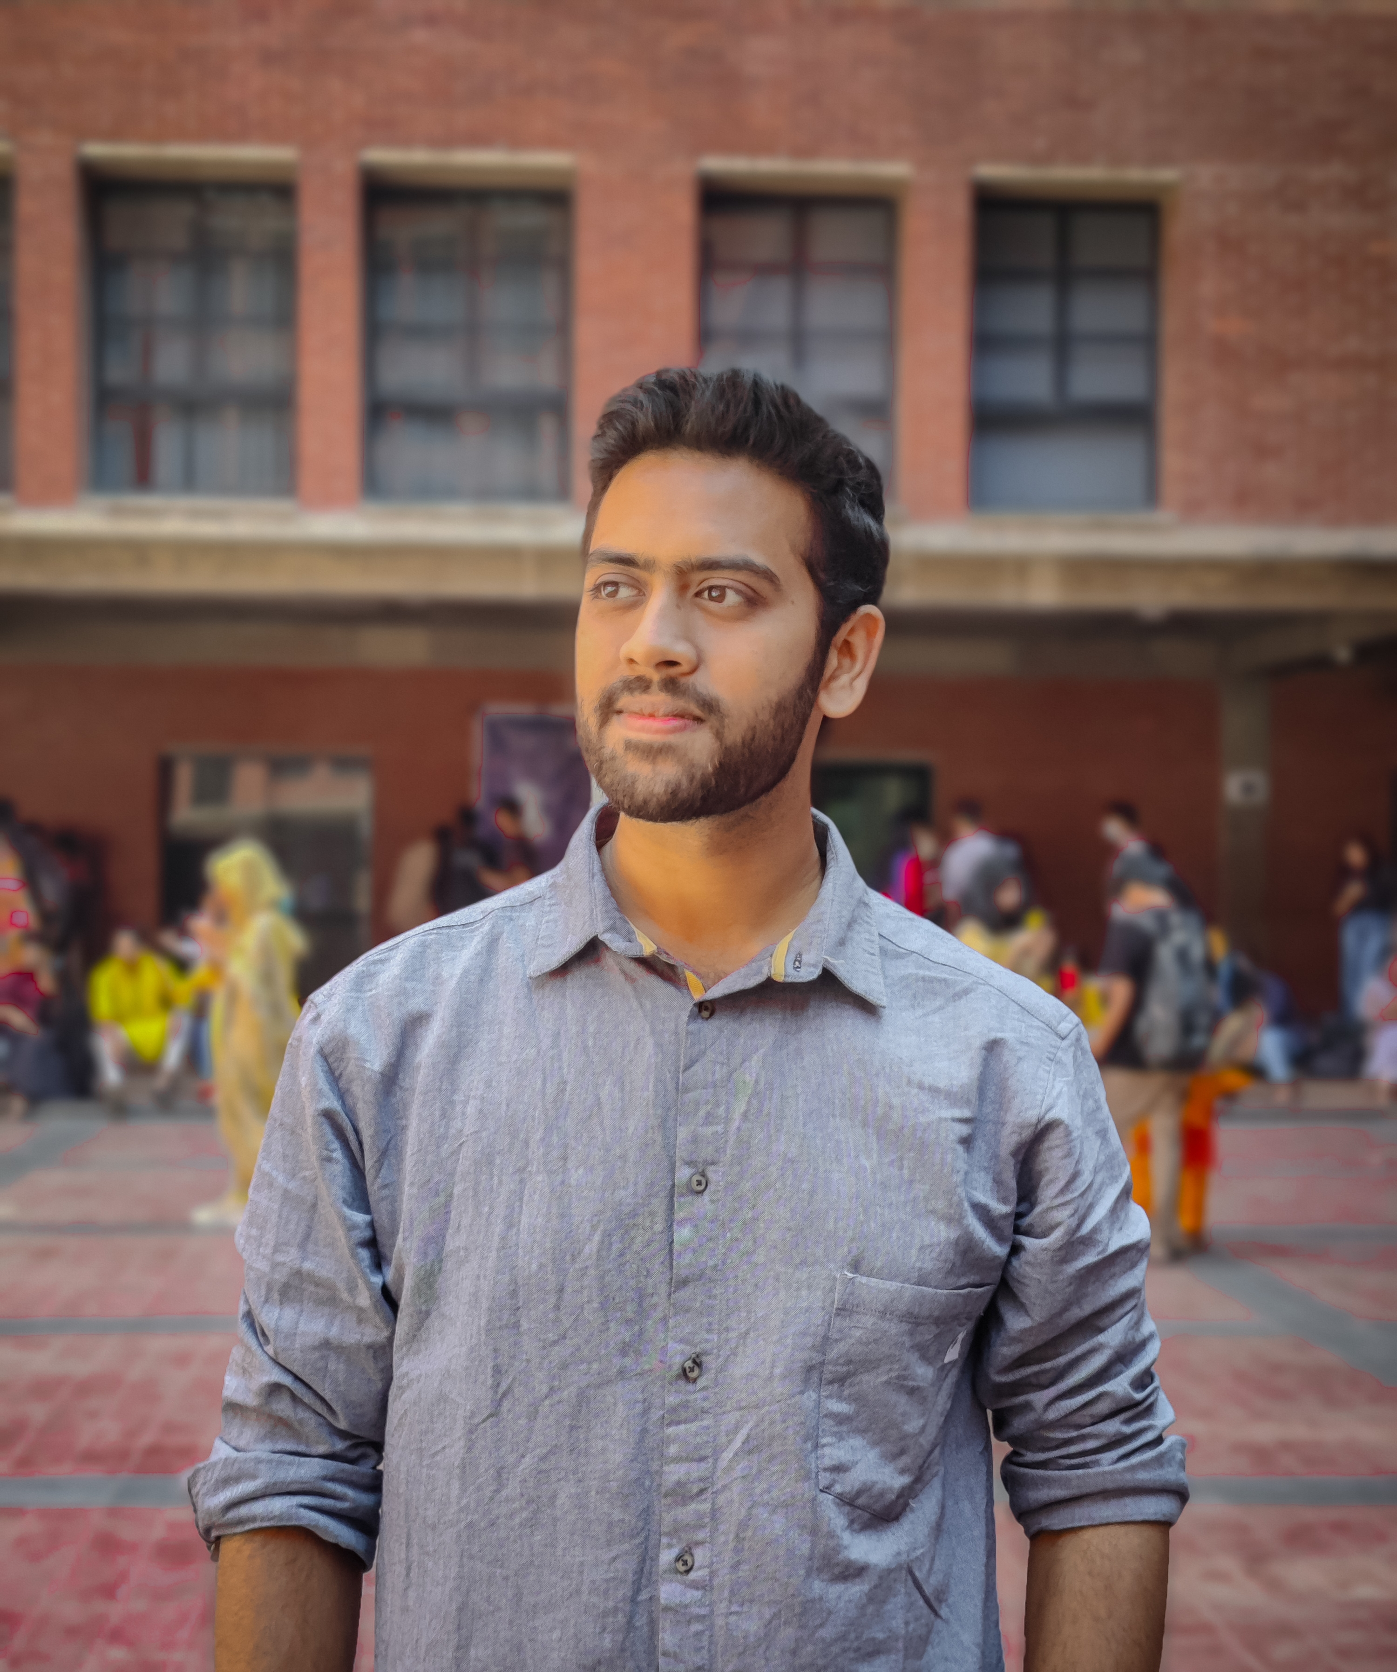


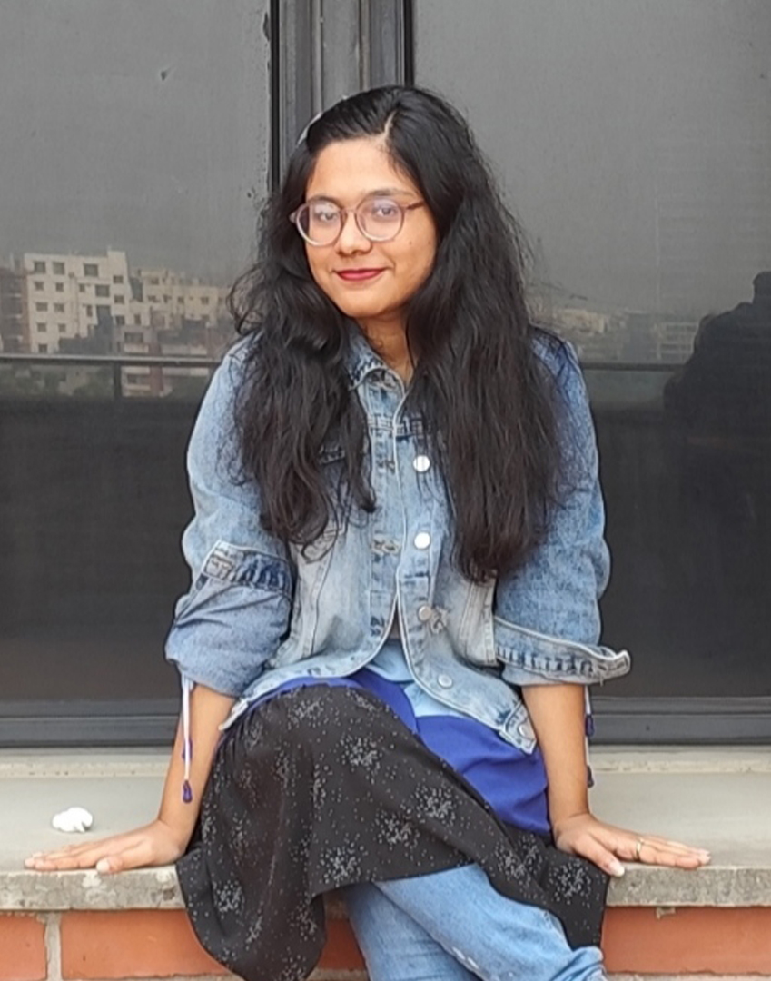

Mohammad Tahmid Noor
2021-3-60-026
B M Shahria Alam
2021-3-60-016
Tasmiah Rahman Orpa
2021-3-60-021
Sidratul Moontaha
2021-3-60-48
Our Team

Slide 4

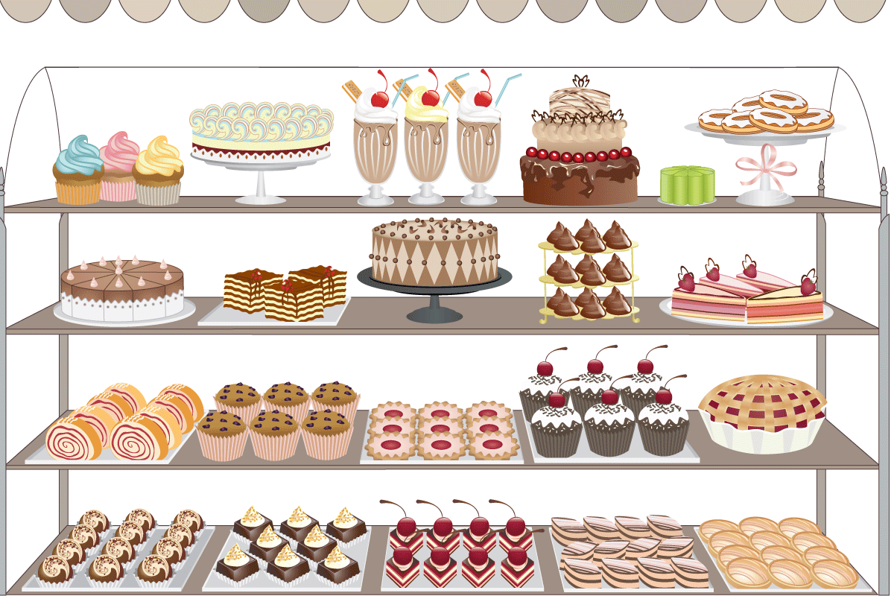
She Bee
Our Project
Cake Shop Management System

Slide 5
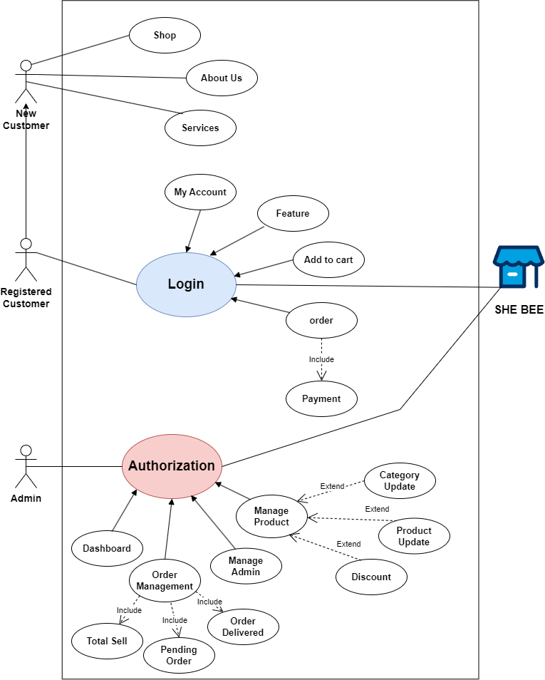
Use case
Diagram

Slide 6

Thank You

